Slide 1
The Relational Model
Can explain the basic concepts of the relational model

Slide 2
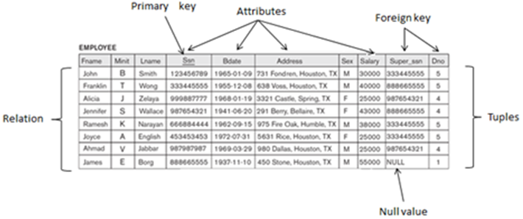
Relational Model Concepts

Slide 3
Relational Model Concepts
A relation is a set (mathematical) of tuples.
Data is organised in a number of tables (relations).
Each table have a number (>=1) columns (attributes).
Attributes have names and are defined over some domain
Attribute values are atomic
Horizontally: Attributes are ordered/unordered For convenience ordered / for more abstraction unordered
Vertically: Tuples are unordered
A table holds a number (maybe none) rows (tuples).
Tuples are unique (existense of a key is guaranteed).

Slide 4
DEFINITION SUMMARY
Informal Terms | Formal Terms
Database | Set of relations
Table | Relation
Column | Attribute
Row | Tuple
Possible values in a column | Domain
Table Definition | Schema of a Relation

Slide 5
NULL
An attribute may have the value “empty”. Empty is notated NULL.
Several meanings for NULL values, such as:
value unknown
value exist but is not available
attribute does not apply to this tuple (also known as value undefined).
Comparison is ambigous (NULL == NULL ?)
SQL: IS NULL / IS NOT NULL

Slide 6
Constraints
There are generally many restrictions or constraints on the actual values in a database state.
Constraints on databases can generally be divided into three main categories:
.. inherent in the data model, called : inherent model-based constraints or implicit constraints.
.. expressed in schemas of the data model (using DDL), called: schema-based constraints or explicit constraints
.. cannot be directly expressed in the schemas of the data model, and hence must be expressed and enforced by the application programs, called: application-based or semantic constraints or business rules.

Slide 7
Constraints
The schema-based constraints include:
Domain constraints
Key constraints
Constraints on NULLs
Entity integrity constraints
Referential integrity constraints

Slide 8
Constraints
Domain constraints
.. the value of each attribute A must be an atomic value from the domain(A). Domains typically associated with data types – other possible:
Subrange of values
Enumerated data type

Slide 9
Constraints
Key constraints
All tuples in a relation must be distinct.
Uniqueness constraint ensured by keys:
Superkey (no two distinct tuples can have the same value for SK).
Key (a minimal superkey), thus:
Unique and
Minimal
Candidate keys – if relation has more keys
Primary key – candidate key designated as primary key.
Other candidate keys are designated as unique.

Slide 10
Constraints
Constraints on NULLs
If NULL values are disallowed then attribute value must not be NULL
PK can’t be NULL

Slide 11
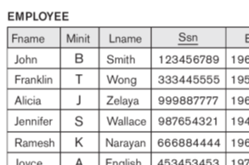

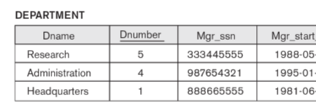
Constraints
Referential integrity constraints
Associations between relations:
Is represented by foreign keys
A foreign key is an attribute (combination) that corresponds to the primary key (combination) of some other relation.
A foreign key references a tuple in an other relations and indicates that here is more information about the entity

Slide 12
Constraints
Referential integrity constraints
The attributes in FK must have the same domain(s) as the primary key attributes PK (or the domains must at least be compatible)
A FK values must occur as PK in the referenced relation or be NULL

Slide 13
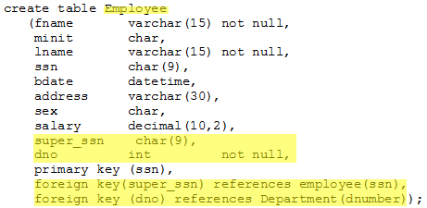
Constraints
We already know these FKs.
How do they differ?

Slide 14
Schema-based constraints
Domain constraints
Attributes must only hold valid values
Key constraints
All tuples in a relation must be distinct (primary key)
Constraints on NULLs
Attribute value must not be NULL
Entity integrity constraints
Primary key attributes must not hold NULL-values
Referential integrity constraints (foreign key constraints)
A foreign key must either be NULL or reference an existing primary key in the other relation

Slide 15
Schema-based constraints
Demo – things go wrong!
Domain constraints
Attributes must only hold valid values
Key constraints
All tuples in a relation must be distinct (primary key)
Constraints on NULLs
Attribute value must not be NULL
Entity integrity constraints
Primary key attributes must not hold NULL-values
Referential integrity constraints (foreign key constraints)
A foreign key must either be NULL or reference an existing primary key in the other relation

Slide 16
Database vs. constraints
Schema and its current state.
A database that does not obey all the integrity constraints is in an invalid state.
A database that satisfies all constraints is called a valid state.

Slide 17
Primary keys and foreign keys
Company database

Slide 18
Update operations And dealing with constraint violations
There are three basic operations that can change the states of relations in the database:
Insert,
Delete
Update (or modify)
Might violate constraints
Domain constraints
Key constraint
Entity constraints
Referential integrity

Slide 19
Update operations And dealing with constraint violations
Operations that can change the states of relations in the database.
Options when violation
Restrict (reject)
Cascade (propagate)
Set null
Set default

Slide 20
Update operations And dealing with constraint violations
The insert operation
Can violate:
Domain constraint
Key constraint
Entity constraint
Referential integrity
Default action: Reject

Slide 21
Update operations And dealing with constraint violations
The Delete operation
Can violate:
Referential integrity
Possible actions:
Restrict (reject)
Cascade (propagate)
Set null
Set default

Slide 22
Update operations And dealing with constraint violations
The Update operation
Updating an attribute that is neither part of a primary key nor of a foreign key usually causes no problems (besides domain constraints)
But:
Modifying PK =~ delete old, insert new
Modifying FK can lead to violation of referential integrity
Use surrogate key!

Slide 23
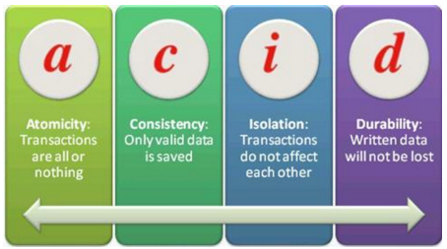
Transactions
A single transaction may involve any number of .. operations .. These retrievals and updates will together form an atomic unit of work against the database.
At the end of a transaction, it must leave the database in a valid state.
Source: http://www.softwaretestinghelp.com/database-testing-process/

